Slide 1
Android Team
ROZIC|COLISTRO|SCHONBERGER|GRAHAM

Slide 2
Scope
Create a mobile application for the service.
Duplicate as much functionality as is possible from the website.
Attempt to make the user experience seamless

Slide 3
Cross-team tasks
Constantly Harassing the database/API team with feature requests.
Only overlap with web team is to ensure that we provide the same, or near-same level of functionality

Slide 4





Tools
Android Studio
Git
Github
JSON
Doxygen

Slide 5
DEMO

Slide 6
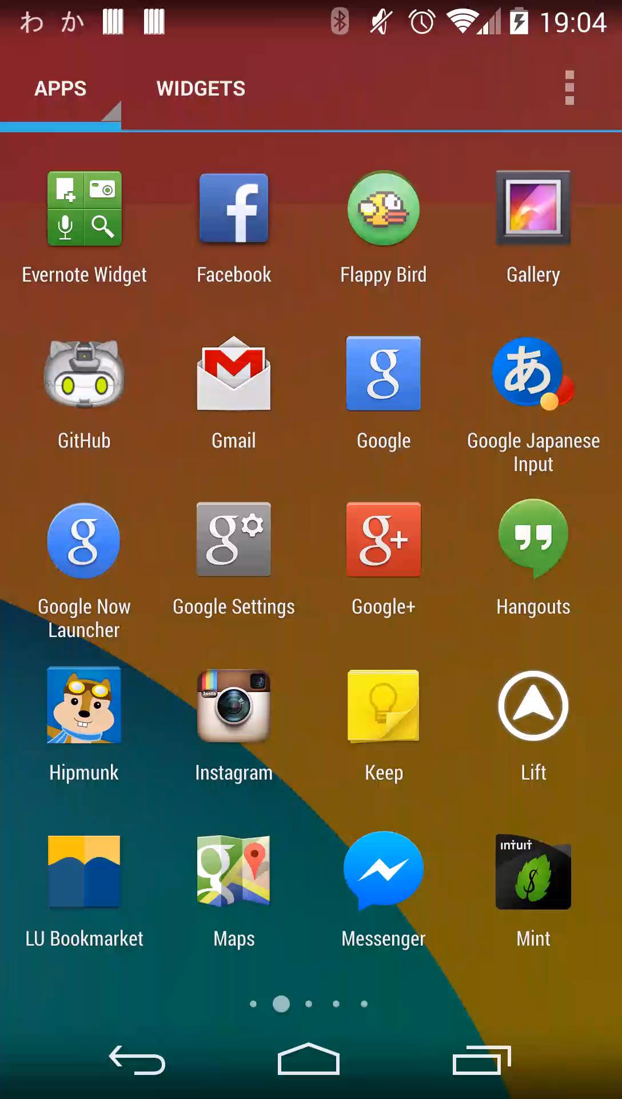
Login/Registration
First checks if current token exists. If so, skip login
Login shows up as first activity on app boot.
Can switch to register by tapping bottom section of the screen.

Slide 7
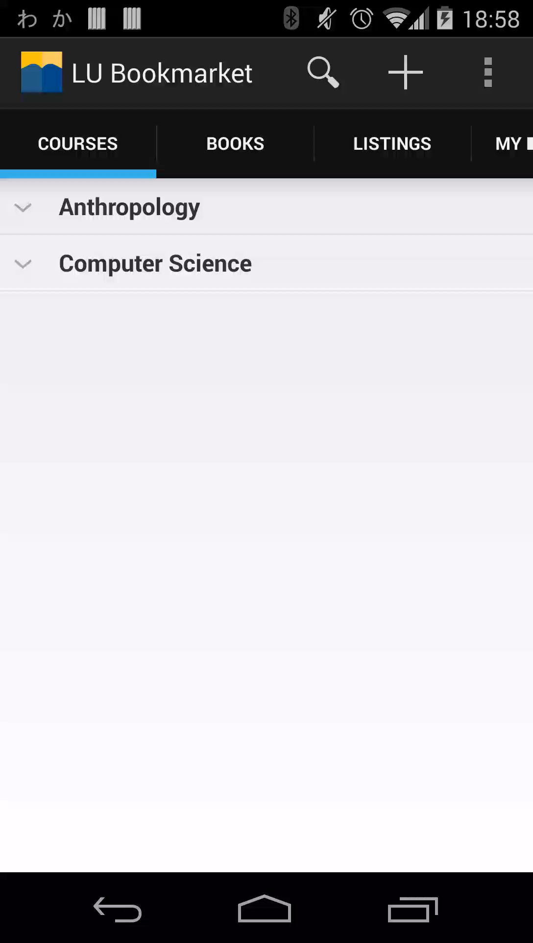
Browsing Courses
Uses Expandable List View to organize by department.
Loads all courses simultaneously.
Summary information includes Course Title/Instructor/Section

Slide 8
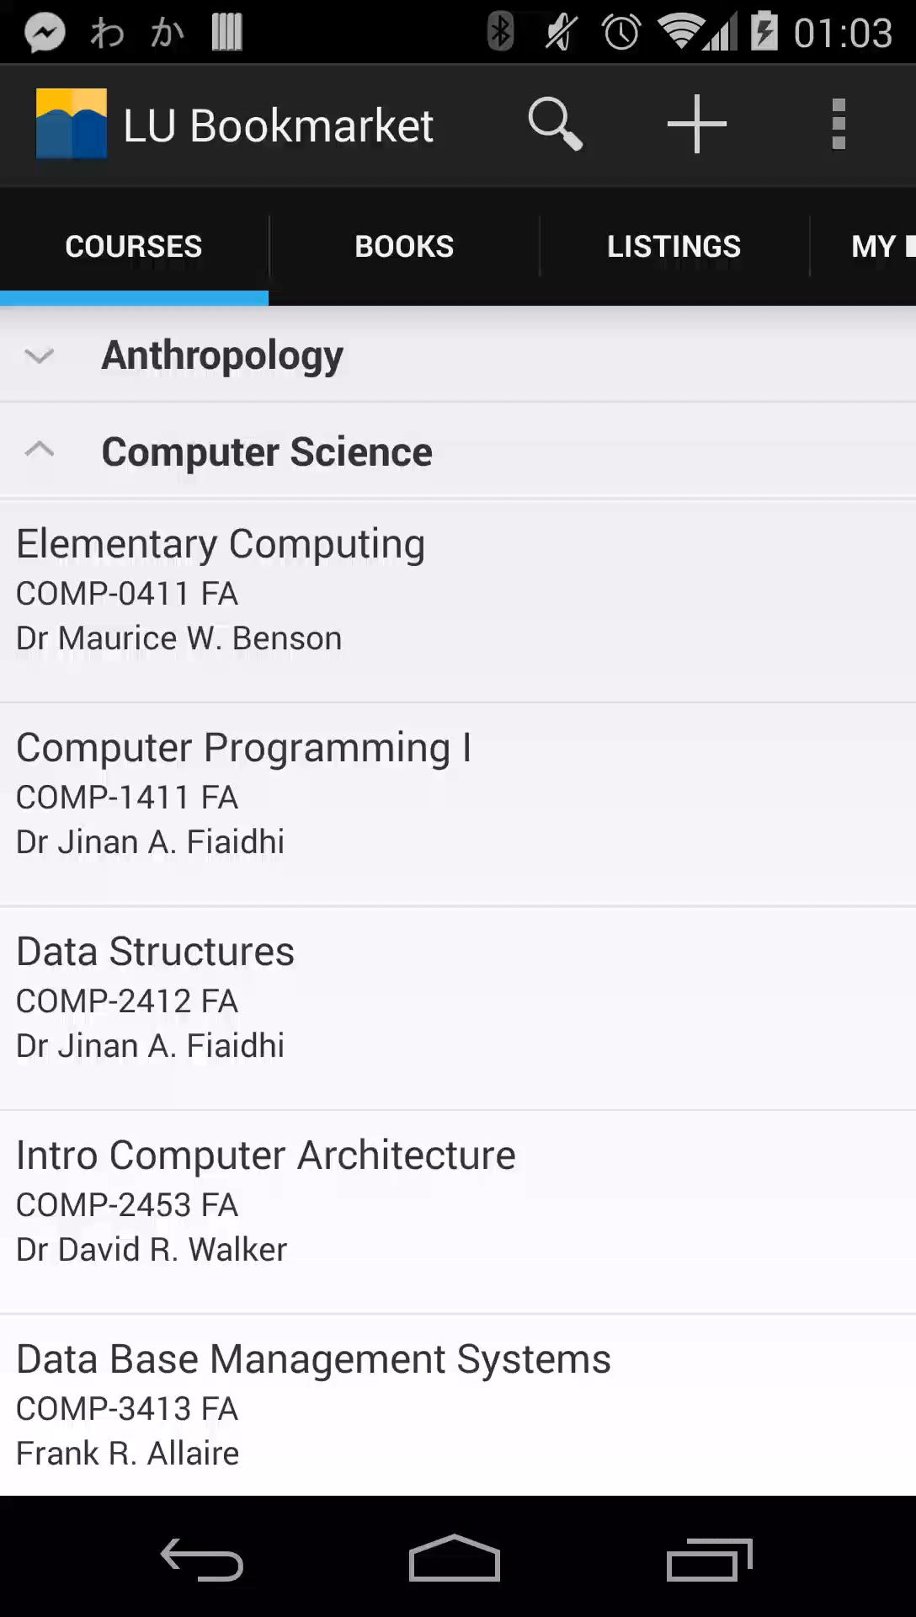
Course Detail
Shows course information
Shows related books, if any.

Slide 9
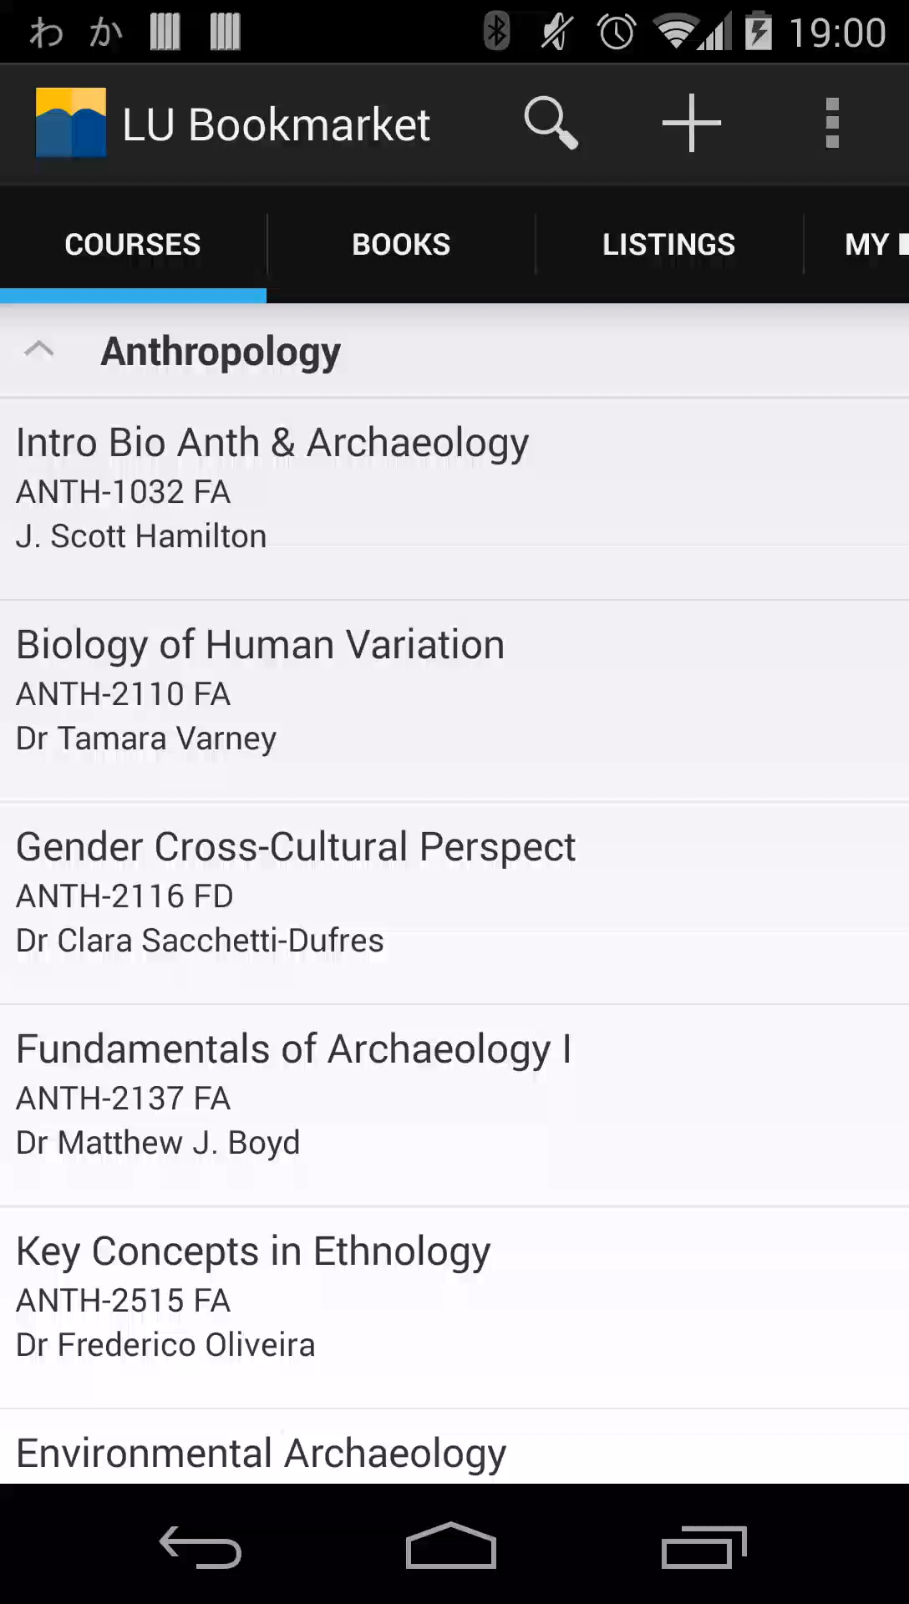
Browsing Books
Loads 20 books at a time using infinite scroll.
Shows preview thumbnail of the textbook for easy recognition.

Slide 10
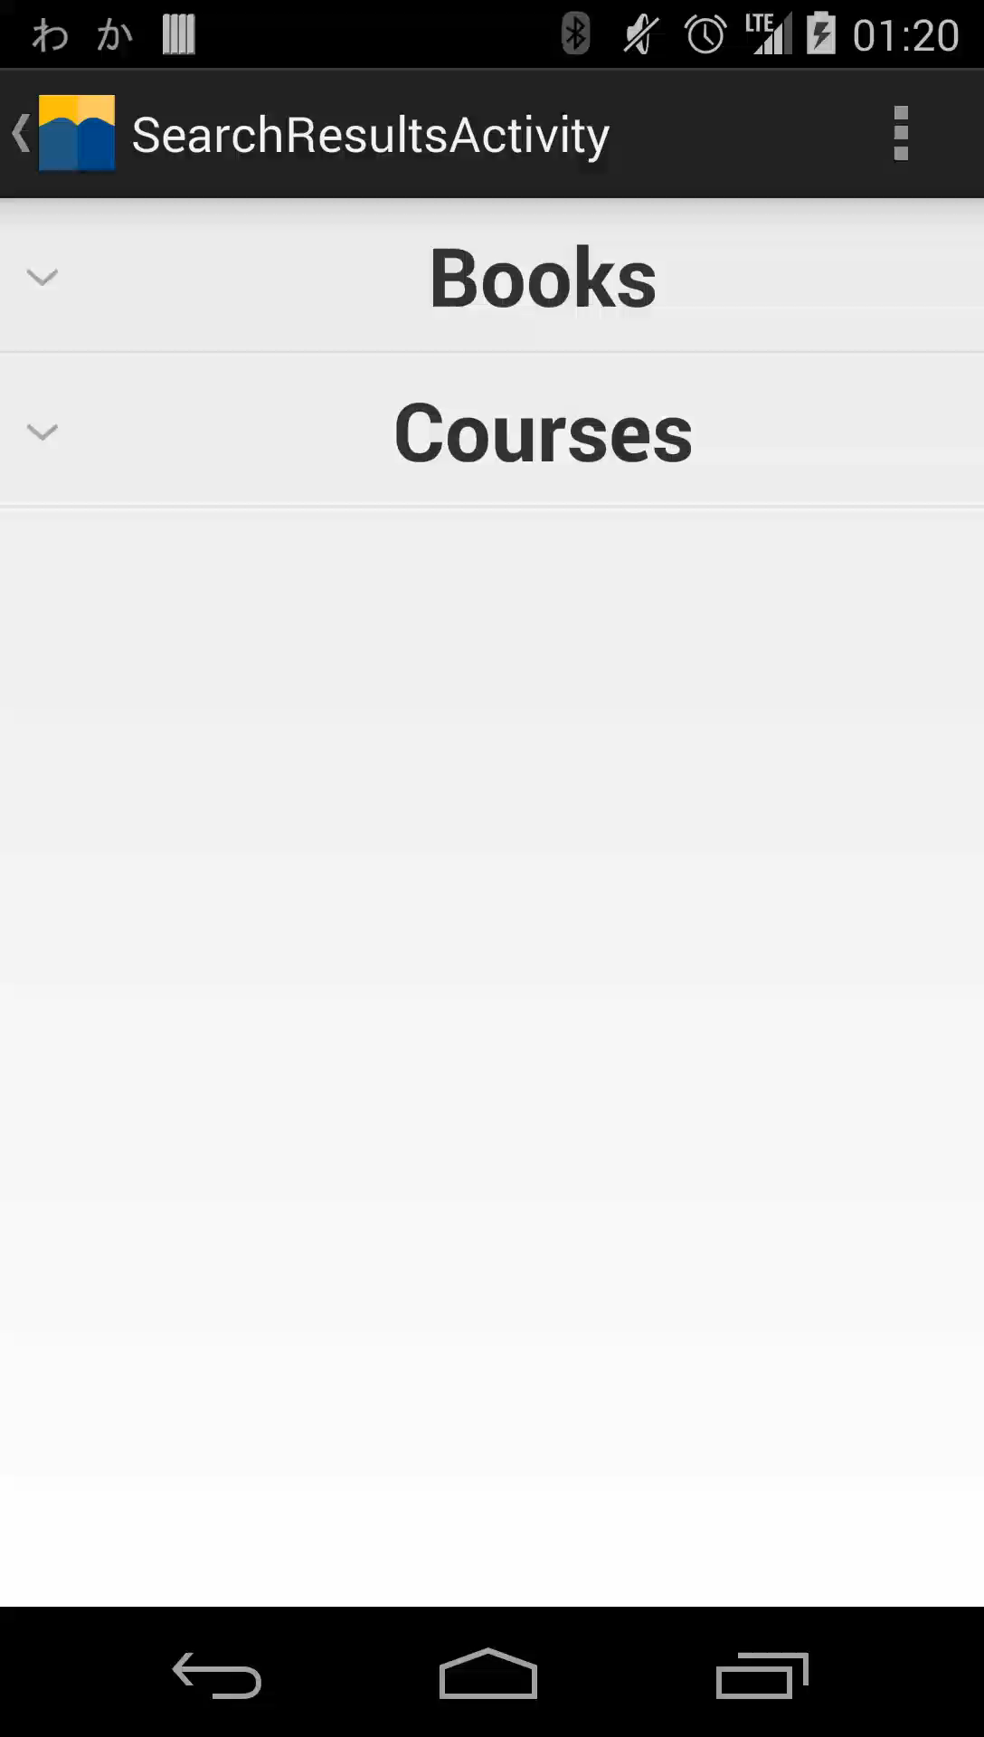
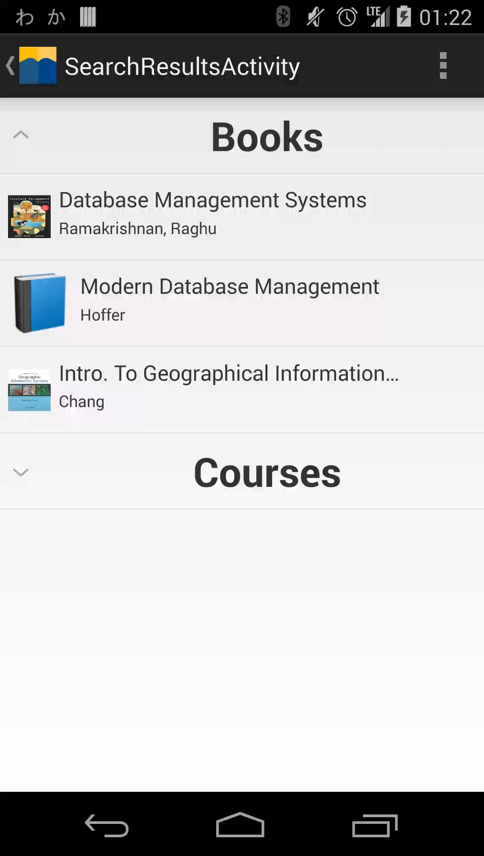
Book Detail
Shows different page depending on whether or not we have any stock.
Can be accessed via search.
Gives details concerning the book.

Slide 11
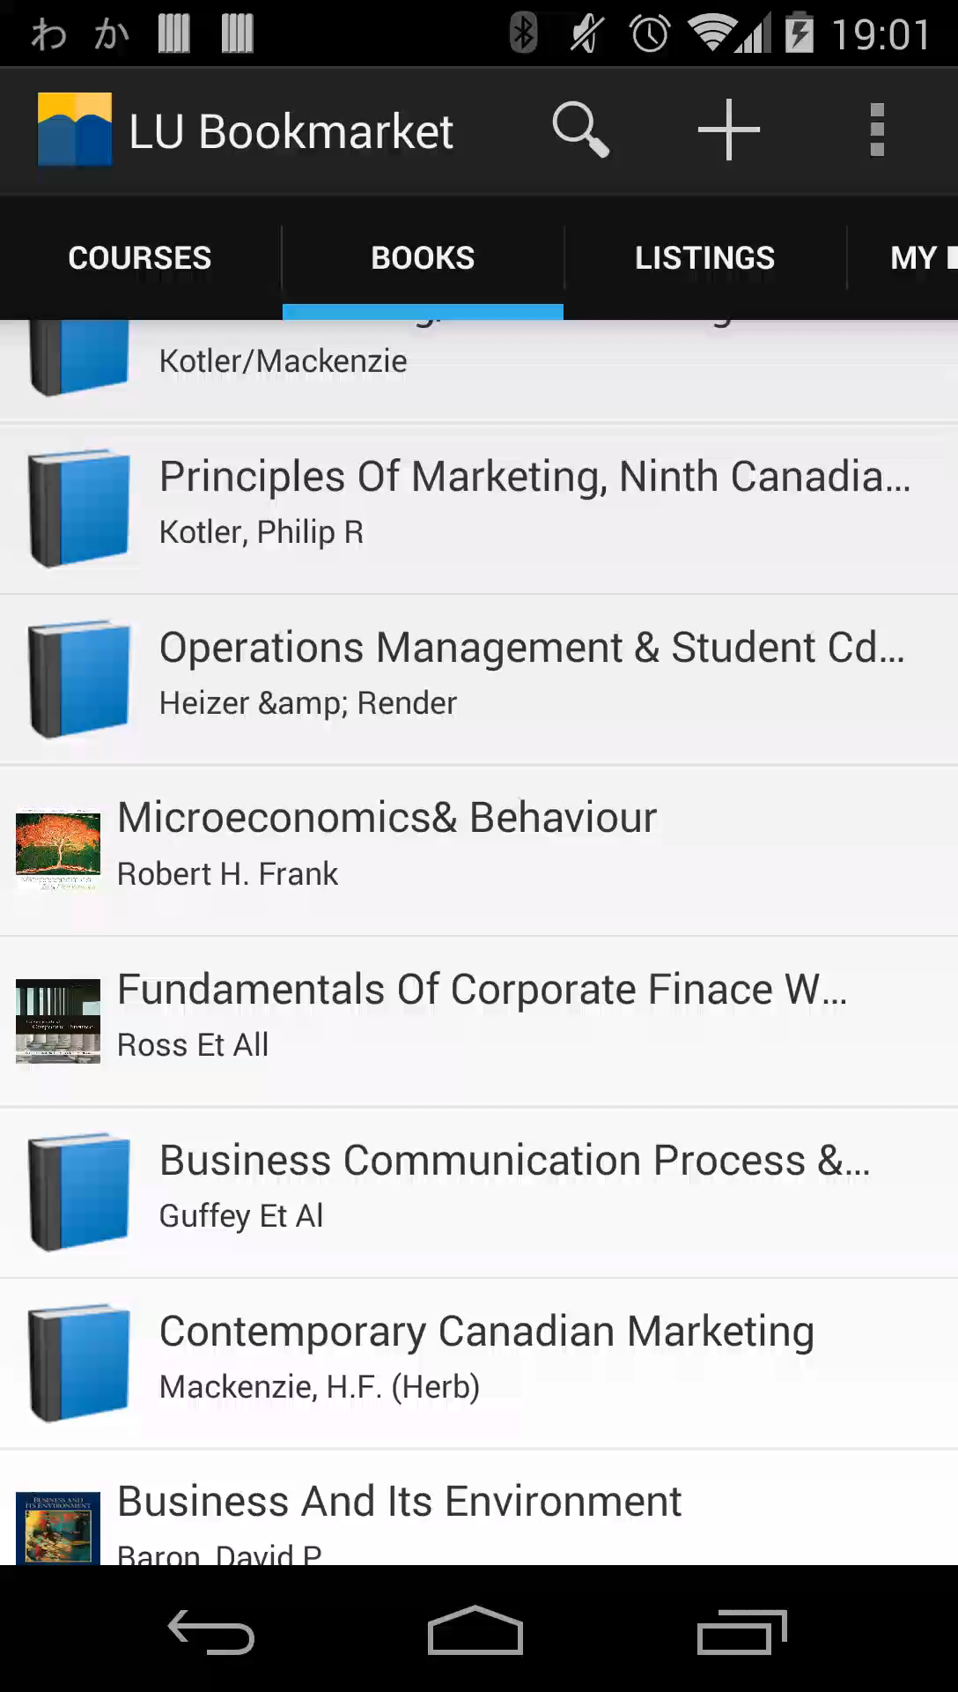
Browsing Listings
Similar to Book View
Shows price and start/end date of the listing
Mail icon allows user to quickly contact the seller.

Slide 12
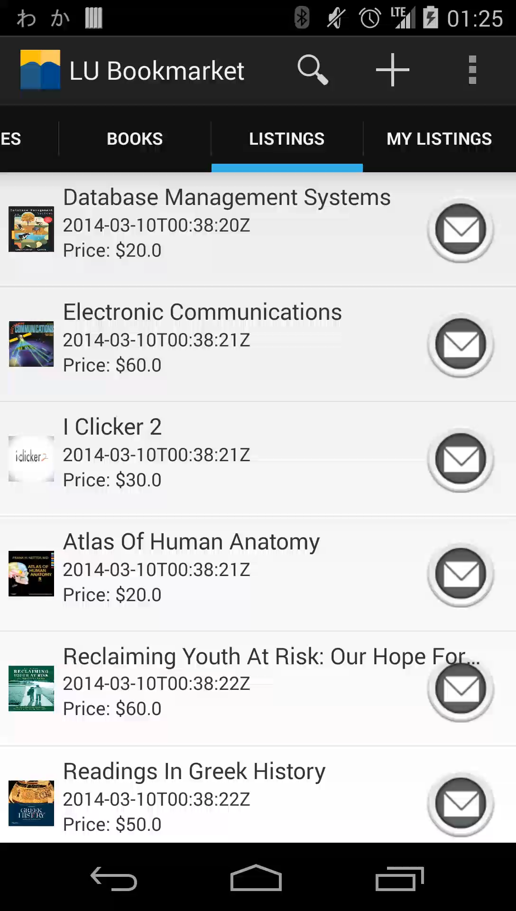
Listing Detail
Shows Listing Price and information.
Shows start and end date
Allows user to contact the seller.

Slide 13

My Listings
Shows current user their own listings
Allows user to remove or modify listing.

Slide 14
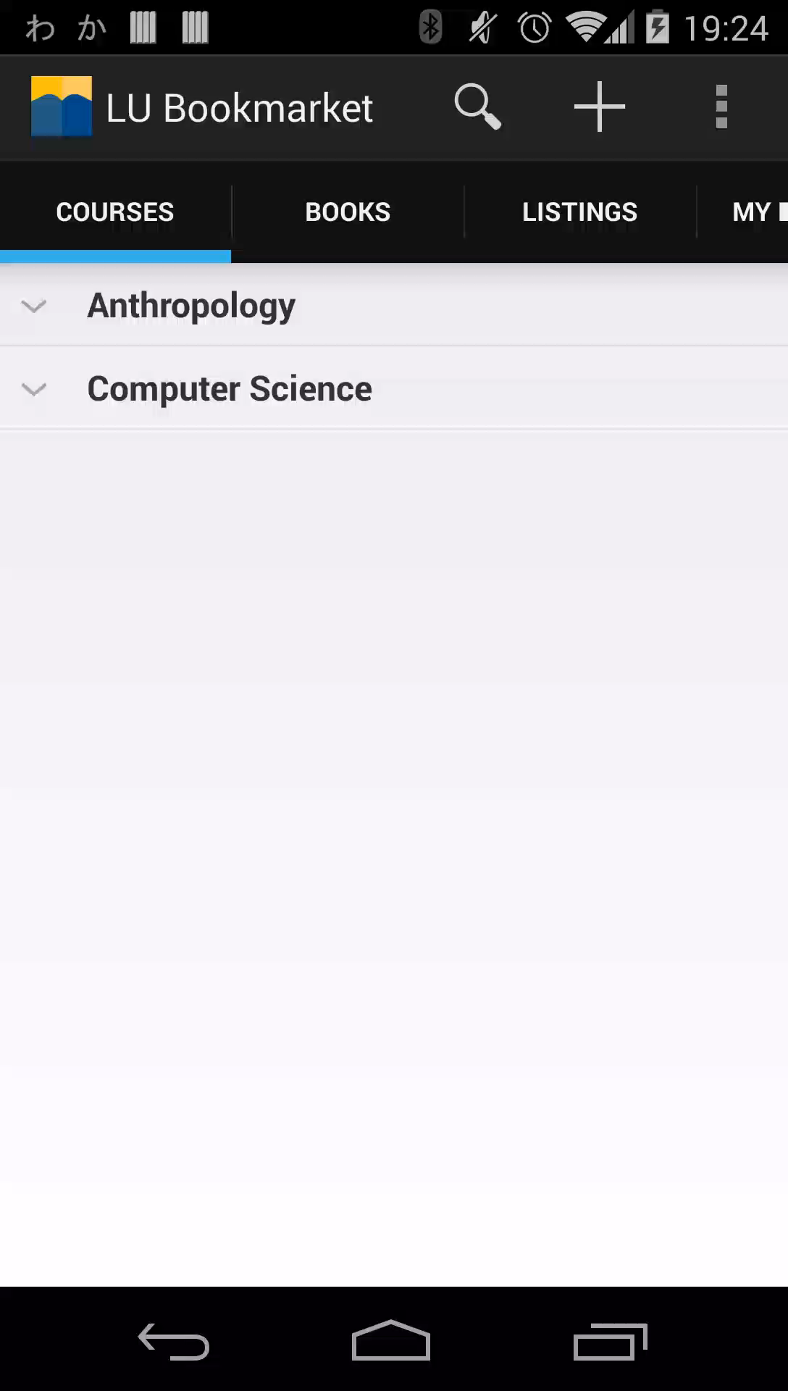
Searching
Launces new Search activity with query.
Search results are returned from the API
Currently, books and courses with keywords in them are returned.

Slide 15
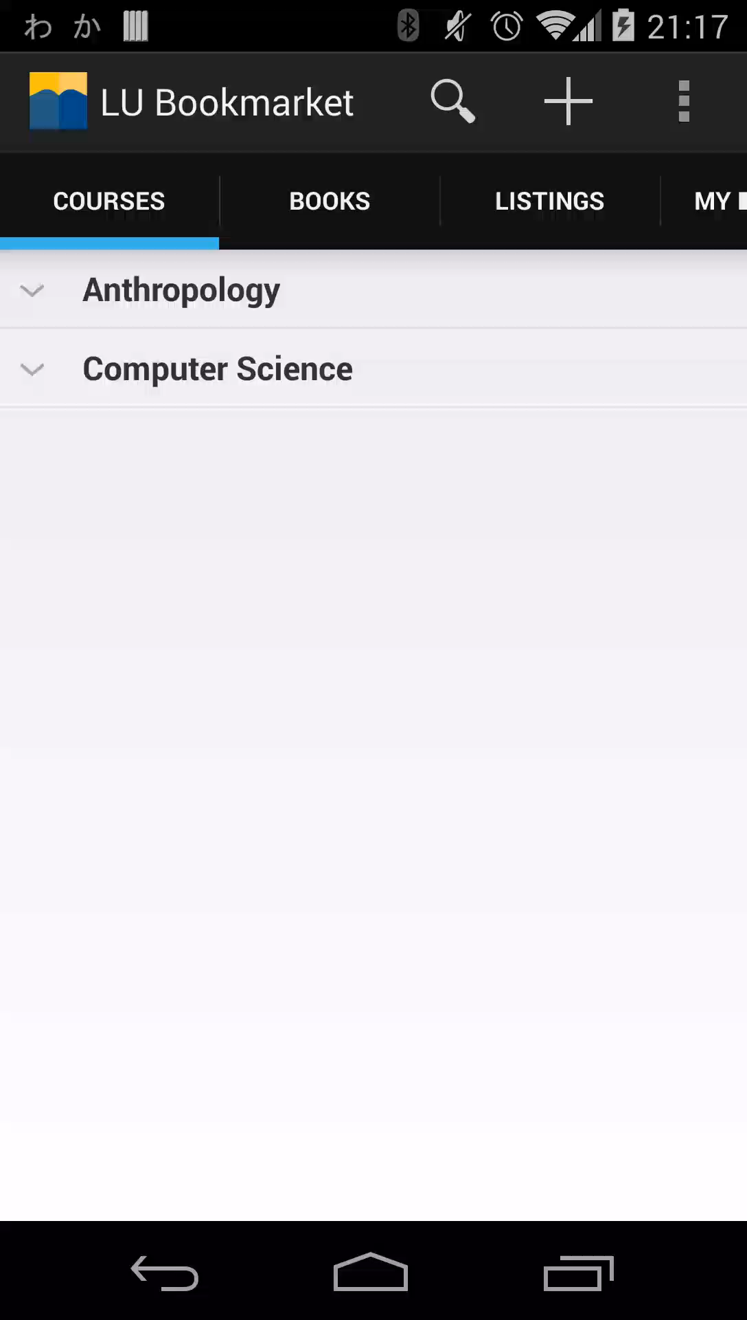
Listing one of your books
Can either Scan or enter ISBN
Forces you to set a price
Returns whether or not the listing was successfully created.

Slide 16
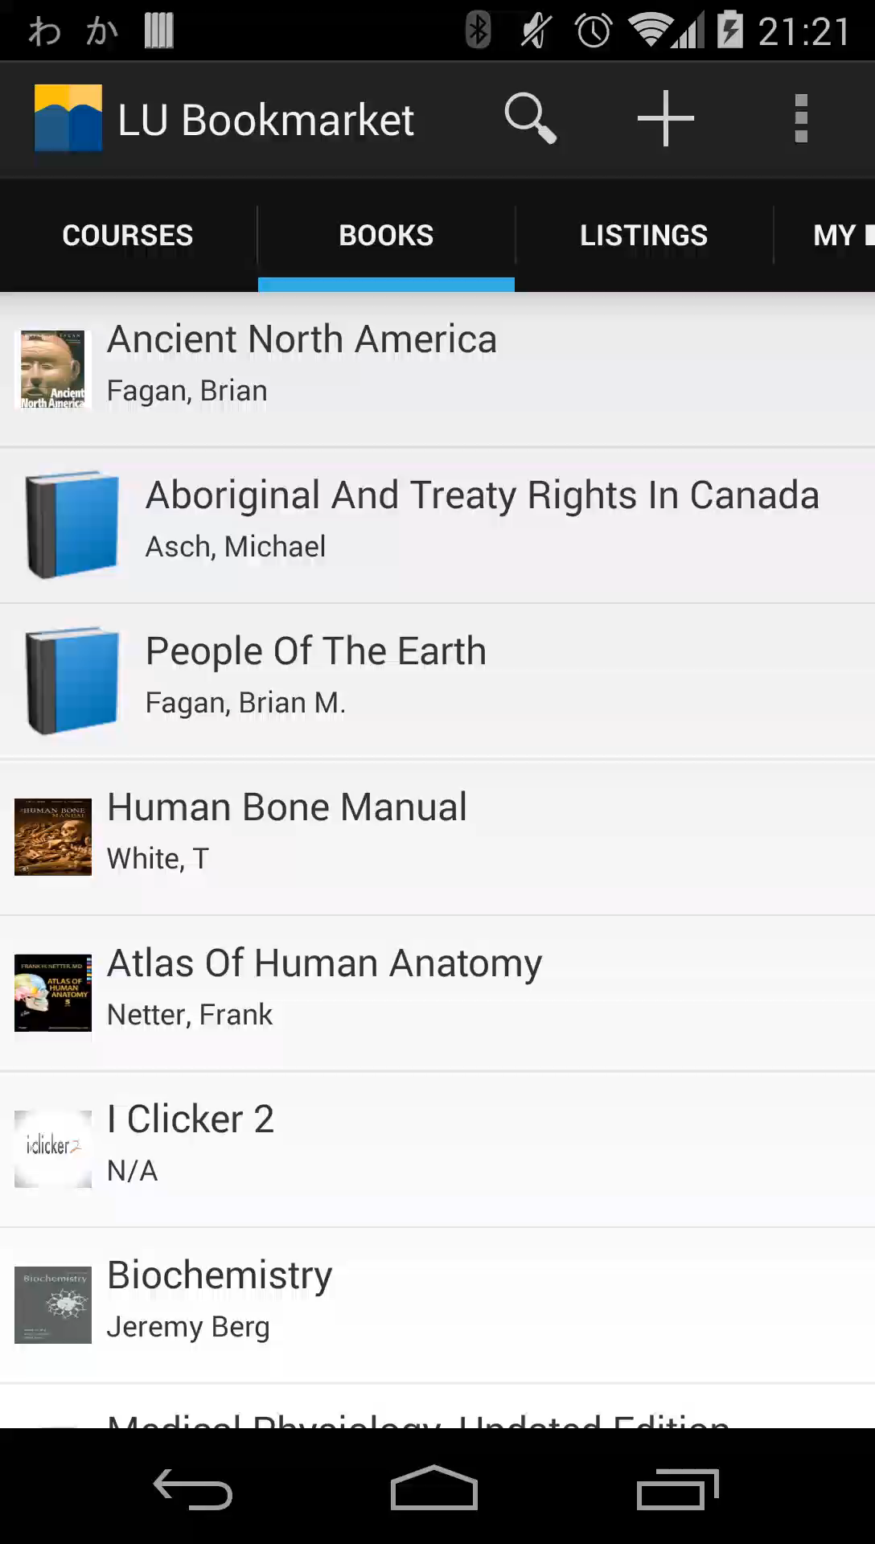
Setting a Major

